Slide 1



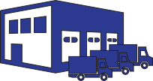
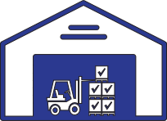





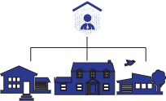




















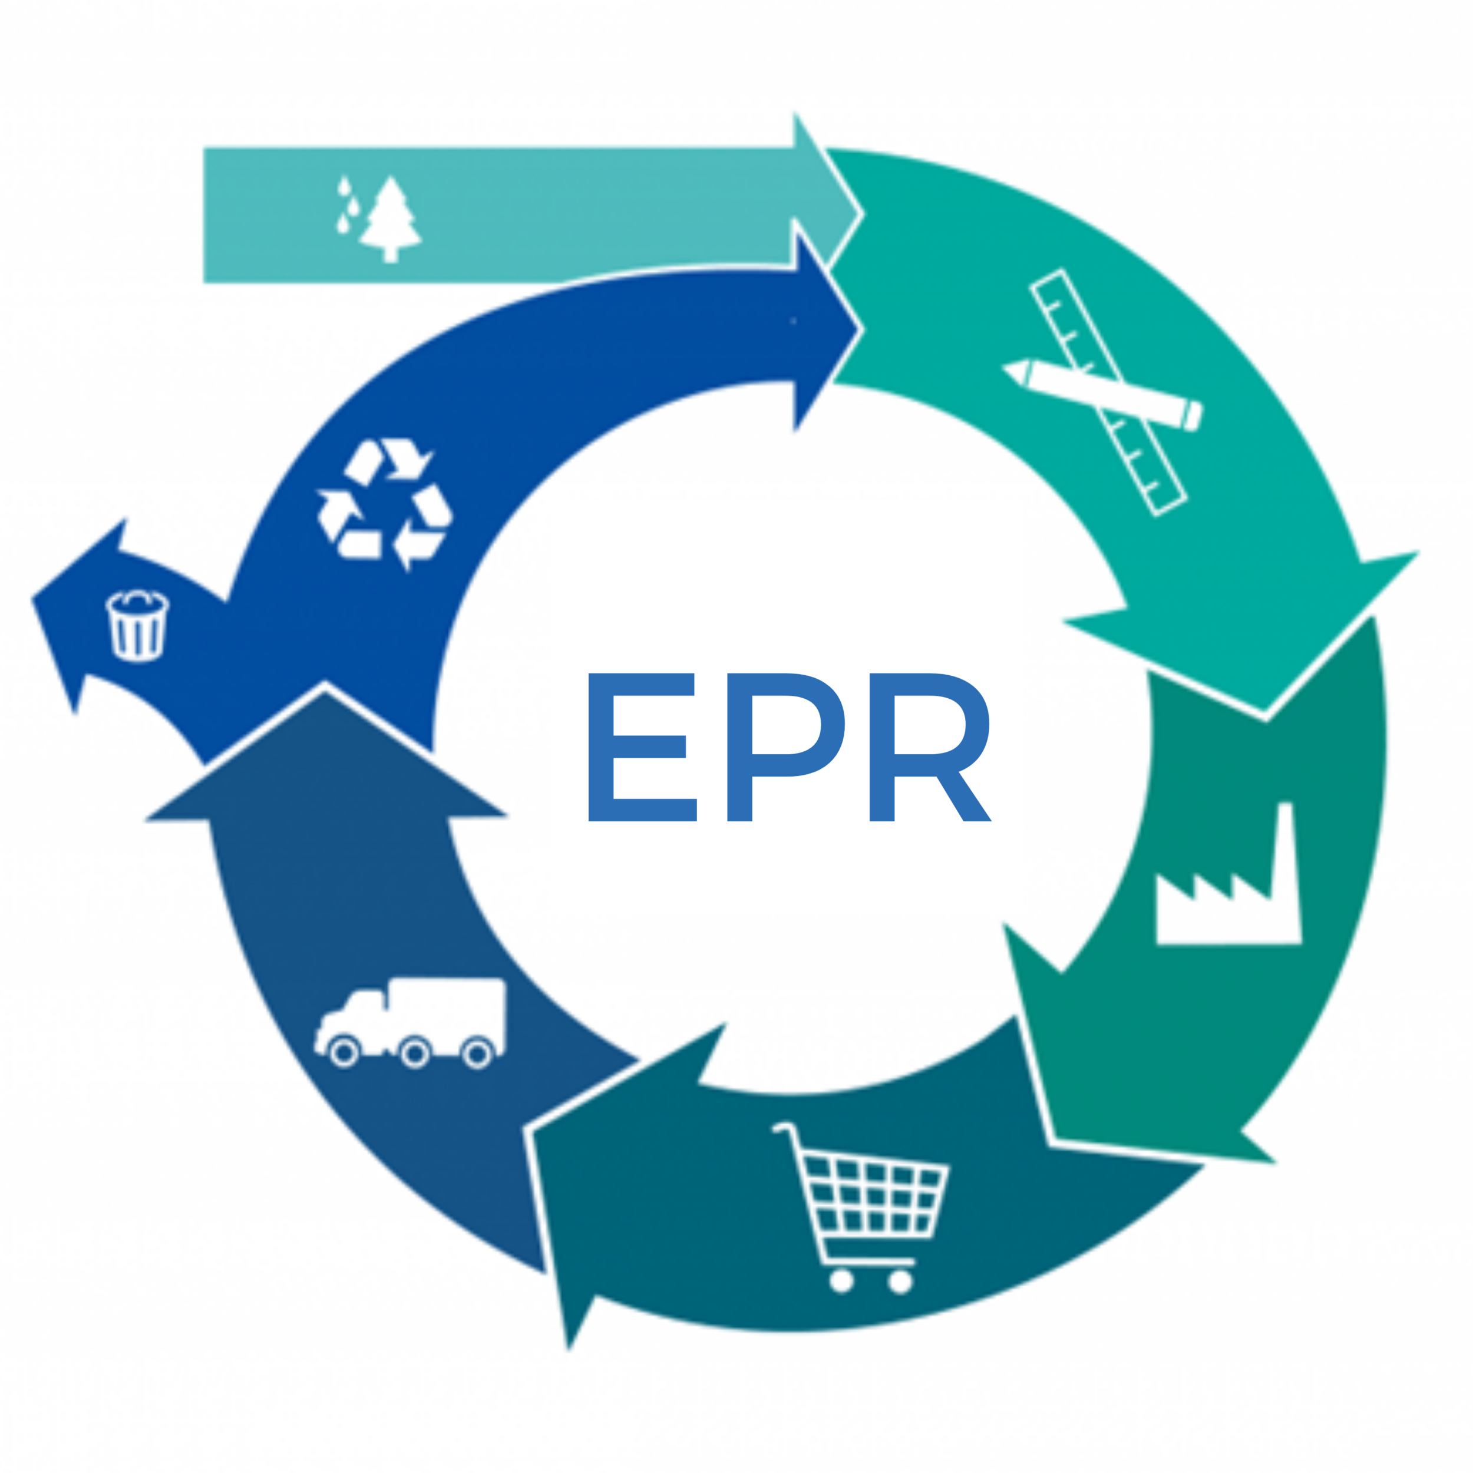

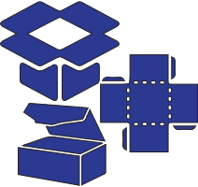

Value chain mapping
Choose one product from your product portfolio
Select a customer segment
Select the actors in the value chain network for this product and customer segment (add actors if necessary)
1
2
3
Your company
Raw materials supplier
Installer
Distributor
Inventory store
Service provider
Contractor
Sub-contractor
Customer
Product user
Facility management
Product designer
Recycler
Waste collector
Logistic partner
Government
Local authority
Financer
Cleaner
Coater
Remanufacturer
Renting company
Component supplier
Assembly factory
Data collector
Architect
Sales office
Matchmaking platform
Project management
Engineering company
Broker
Waste pre-processer
Decommissioning company
EPR-organisation
Data analyser
Packaging pooler
OEM
Actor
Actor
Actor
Place actors in the sequence in which they interact with your product / service
Draw arrows (goods, services, data, revenue)
Discuss with involved actors and iterate !
4
5
6

Slide 2
Value chain reflections
Do you know/see the entire value chain?
Is all the info on the diagram 'validated' info or are there also assumptions?
  Identify the assumptions!
Can you identify the key actors for circularity?
  What do you know about them?
  Are you in touch?
1
2
3
What adjustments in this chain can you think of to enable more circularity (for all R-strategies)?
  Which products/components/materials/raw materials streams would become more circular ?
  Who will be impacted if this adjustment were to take place?
    Which actors might benefit
    Which actors might loose
4

Slide 3
Name of flow: Product type: Customer segment: Date/version:
Goods flow
Data/info flow
Finance flow
Services

